Slide 1
CMSC 491/691 Malware Analysis
Intro to Malware Analysis

Slide 2
Topics
Malware detection, classification, attribution
Categories of Malware
Types of Malware Analysis

Slide 3
Malware Detection, Classification, and Attribution

Slide 4
Malware Detection
Is a given file benign or malicious?
Malicious indicator
Trait of a file that suggests it may not be benign

Slide 5
Malware Classification
Given a malware sample, what category does it belong to?
Will discuss some broad categories of malware soon
What family does the malware sample belong to?
Will also talk about some notable families

Slide 6
Malware Attribution
Who is responsible for a cyberattack?
Need to consider IOCs and TTPs when doing attribution
Indicators of Compromise
Tools, Techniques, and Procedures

Slide 7
Indicators of Compromise (IOCs)
Evidence left by cyberattack
Examples:
Malware samples
Infrastructure
IP addresses
Domain names
Email addresses

Slide 8
Tools, Techniques, Procedures (TTPs)
Usual behavior / methods used by a threat actor
Some examples of TTPs:
Who does the threat actor usually target?
What infection vector does the threat actor normally use?
What are the goals of the threat actor?

Slide 9
Categories of Malware

Slide 10
Worm
Replicates itself and spreads automatically over a network
Attempt to infect as many computers as possible
Usually exploits a vulnerability to do so

Slide 11
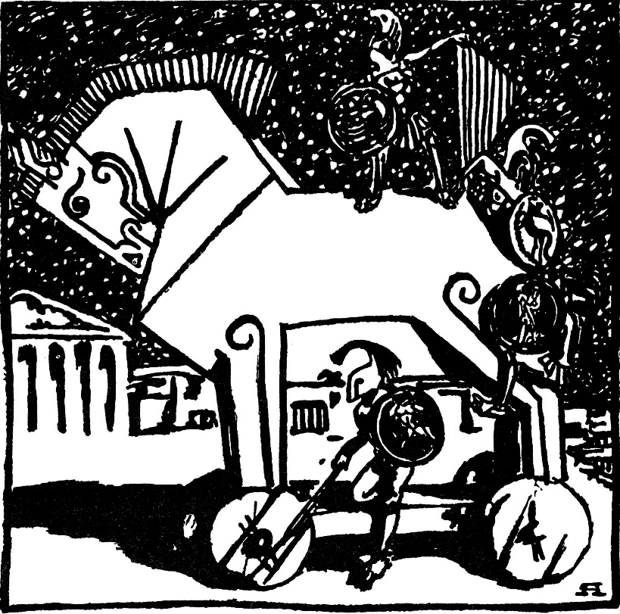
Trojan (Trojan Horse)
Malicious program that appears to have a useful function
Often spread by social engineering
Email attachments
Clicking on malicious links/ads
Payloads can be a variety of things, including backdoors, ransomware, etc.

Slide 12
Worm Example: Conficker
Exploits the MS08-067 vulnerability
Vulnerability was patched before the worm came out
Still propagating a decade later
Mostly on unpatched legacy systems
Estimated 9 to 15 million computers infected since 2008
The authors of the worm still have not been identified

Slide 13
File Infector
Also commonly called a virus
Not all malware is a virus!
Inserts its own code into executable files to persist and spread
When the infected executable is run, the virus also executes
Can spread if the infected executable is copied onto another system and run

Slide 14
Backdoor
Allows a threat actor to remotely access infected computer, bypassing authentication

Slide 15
Remote Access Tool/Trojan (RAT)
Gives actor remote access to, and a high level of control over, the infected computer
Example of RAT:
Poison Ivy, which can log keystrokes, spy on the victim’s actions, steal password hashes, transfer files, etc.
Since 2008, many different APT groups have used Poison Ivy variants in their campaigns
Very popular tool, simple to use
Information from https://www.fireeye.com/content/dam/fireeye-www/global/en/current-threats/pdfs/rpt-poison-ivy.pdf

Slide 16
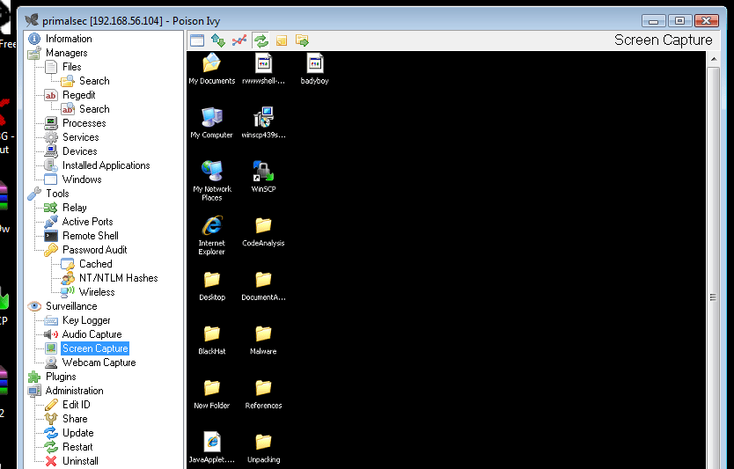
RAT Example: Poison Ivy
Screenshot of Poison Ivy use, showing victim’s screen within the GUI framework
Image from http://www.primalsecurity.net/poison-ivy-remote-access-tool-rat/

Slide 17
Botnet
Refers to a large number of computers being controlled simultaneously by a single actor
Anywhere from a few thousand to a few million
Often used to send spam emails and launch DDoS attacks
Differs from RAT, where the actor has fine control of a machine
With a botnet, the actor can give commands to many machines
Different desired outcomes, different means of achieving them

Slide 18
Credential Stealer
Attempts to steal the victim’s credentials
Usually done using keylogging or by dumping password hashes

Slide 19
Banking Trojan
Trojan that listens for banking login credentials
Most famous example:
Zeus, which triggered when certain URLs were visited, and inserted JavaScript code into a legitimate bank’s website pages
Estimate of over $100 million in losses/damages since 2007
Source code was leaked in 2011
Other malware authors used this leaked code to create dozens of variants that are still active today
Information taken from https://www.trendmicro.com/vinfo/us/security/news/cybercrime-and-digital-threats/online-banking-trojan-brief-history-of-notable-online-banking-trojans

Slide 20
Ransomware
Encrypts data and demands payment to decrypt victim’s files
Often asks for payment in cryptocurrency
Causes billions of dollars in losses/damages each year
Quicker and more direct method of making money than banking trojans
Don’t have to wait for a user to log into their account

Slide 21
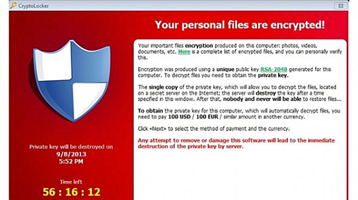
Ransomware Example: CryptoLocker
One of the earliest successful ransomware families, popularized ransomware
Infected over 250,000 computers and earned over $3 million in 2013

Slide 22
Cryptojacker (Cryptocurrency Miner)
Silently mines cryptocurrency for cybercriminals
Current cybercriminal favorite as of late 2017
Much stealthier and does not require the victim to do anything

Slide 23
Rootkit
Maintains covert access to infected system
Actively masks its existence
Two types: user mode and kernel mode
User mode runs at same level as other user applications
e.g., Intercepts calls to APIs to prevent listing its files in a directory
Kernel mode runs with the highest privileges
e.g., Adds or replaces portions of the OS itself

Slide 24
Destructive Malware
Makes the infected system unusable
Often by disk wiping
Recent example: NotPetya
Originally classified as a ransomware worm that spread by exploiting EternalBlue in 2017
Seemed to be a variant of the Petya ransomware
Encrypts parts of the master boot record and intentionally makes system unrecoverable, even if the ransom is paid
Now classified as destructive malware / worm

Slide 25
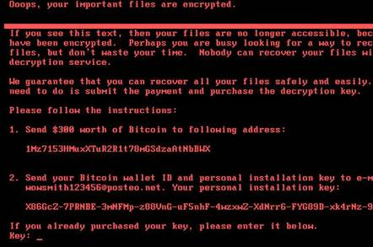
Wiper Example: NotPetya
Heavily targeted computers in Ukraine, caused over $10 billion in damages
One of the costliest, if not the costliest cyberattack to date
Attributed to the Sandworm APT group, which is Russian state-sponsored
Image from https://www.theregister.co.uk/2017/06/28/petya_notpetya_ransomware/

Slide 26
Types of Malware Analysis

Slide 27
Basic Static Analysis
Examining the malware while it is “at rest”
Strings
Imports
Metadata

Slide 28
Basic Dynamic Analysis
Observing the output and/or changes when the malware is run
But not interfering or interacting with the malware
How it interacts with:
Filesystem
Network
Registry

Slide 29
Advanced Static Analysis
Analyzing the malware sample’s code to understand what it does
Done using a disassembler

Slide 30
Advanced Dynamic Analysis
Using a debugger to observe / control the malware as it executes
Registers
Stack
Memory
Code

